Slide 1

Outlook 2026
The Policy Engine

Slide 2
The More Things Change, the More They Stay the Same
Economy

Slide 3
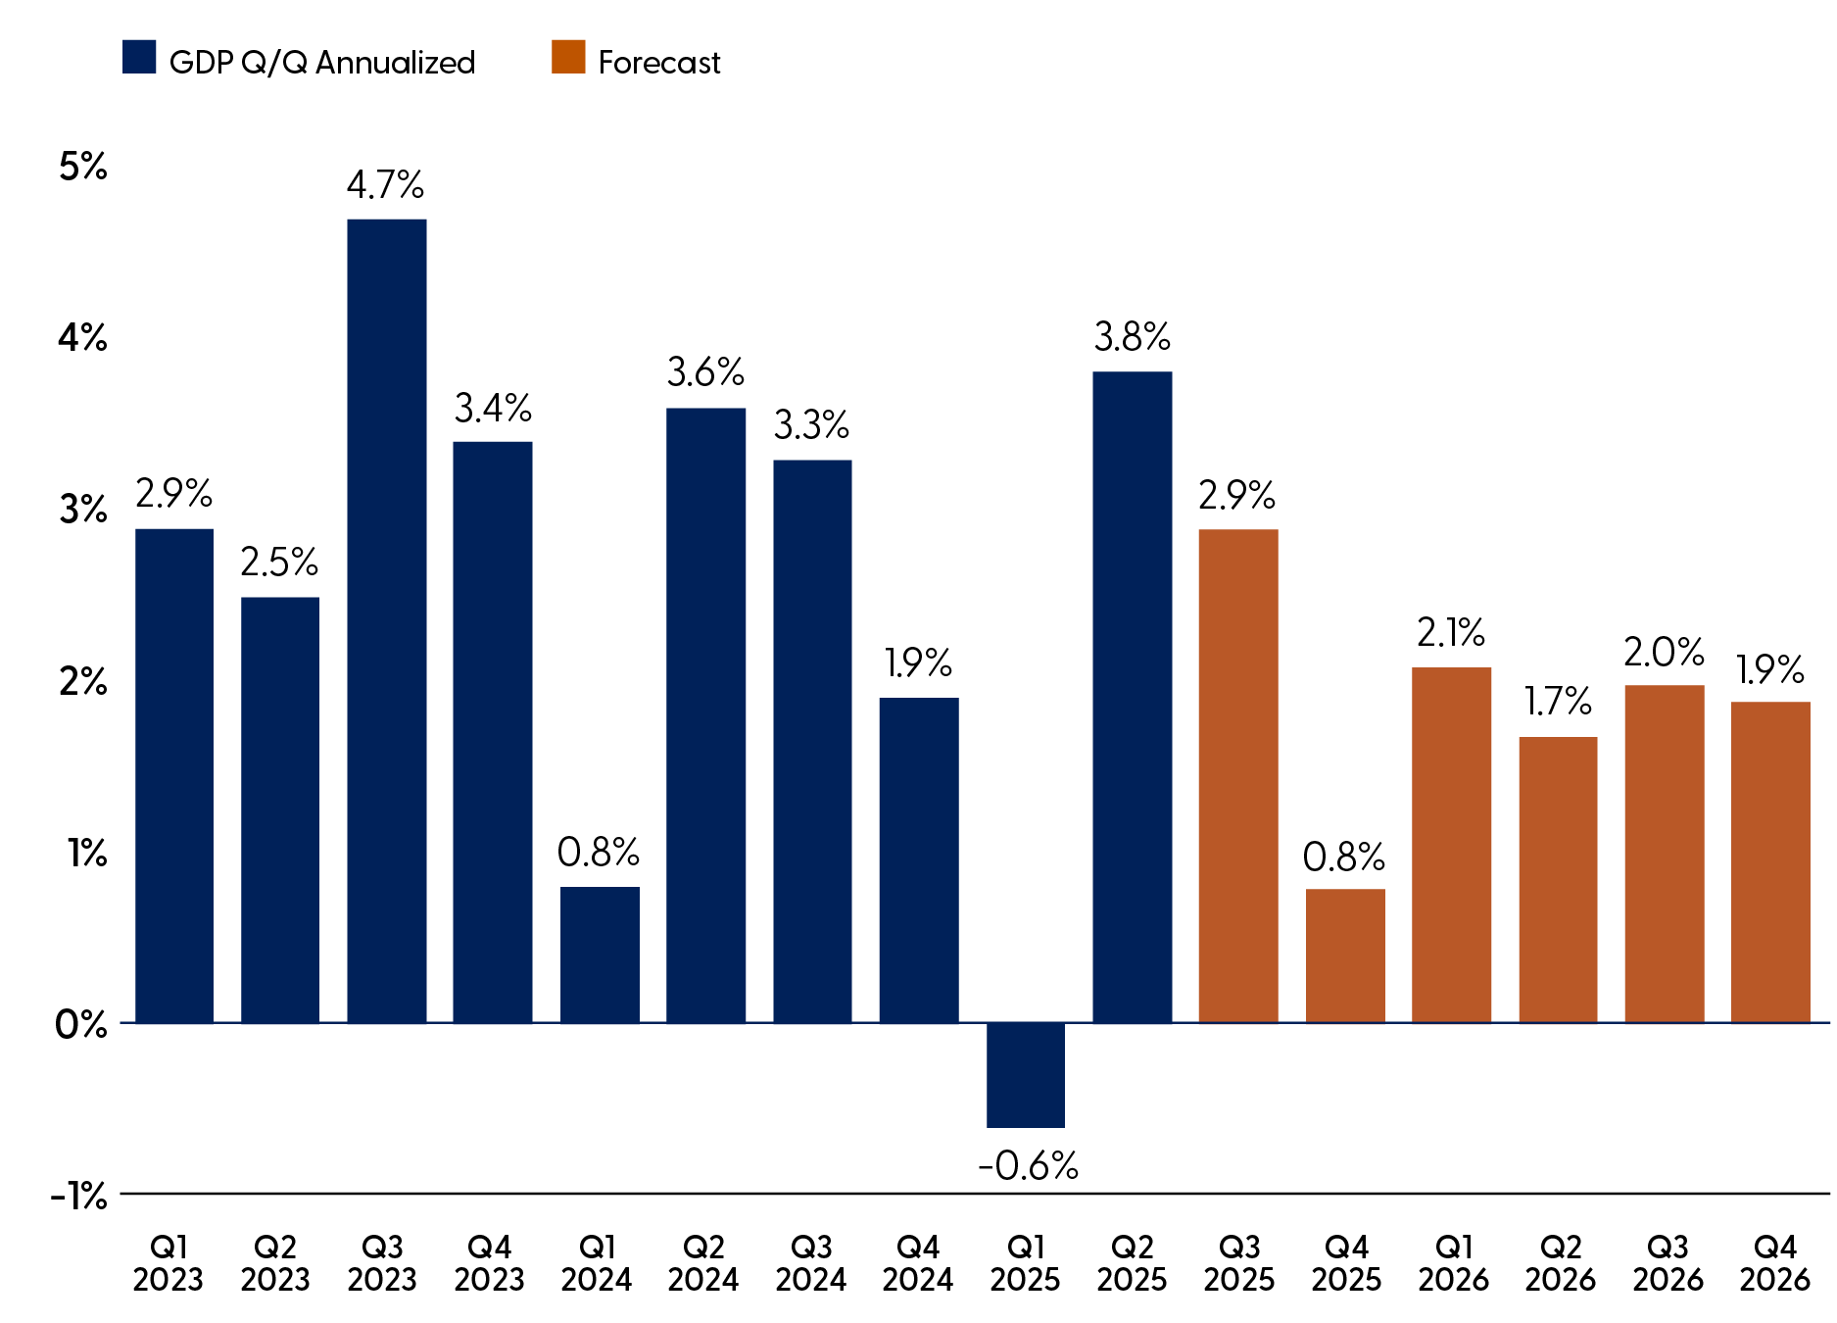
Expect Modest Rebound in GDP in Latter Half of 2026
Source: LPL Research, U.S. Bureau of Economic Analysis, 12/01/25. Past performance is no guarantee of future results. Estimates may not materialize as predicted and are subject to change.

Slide 4
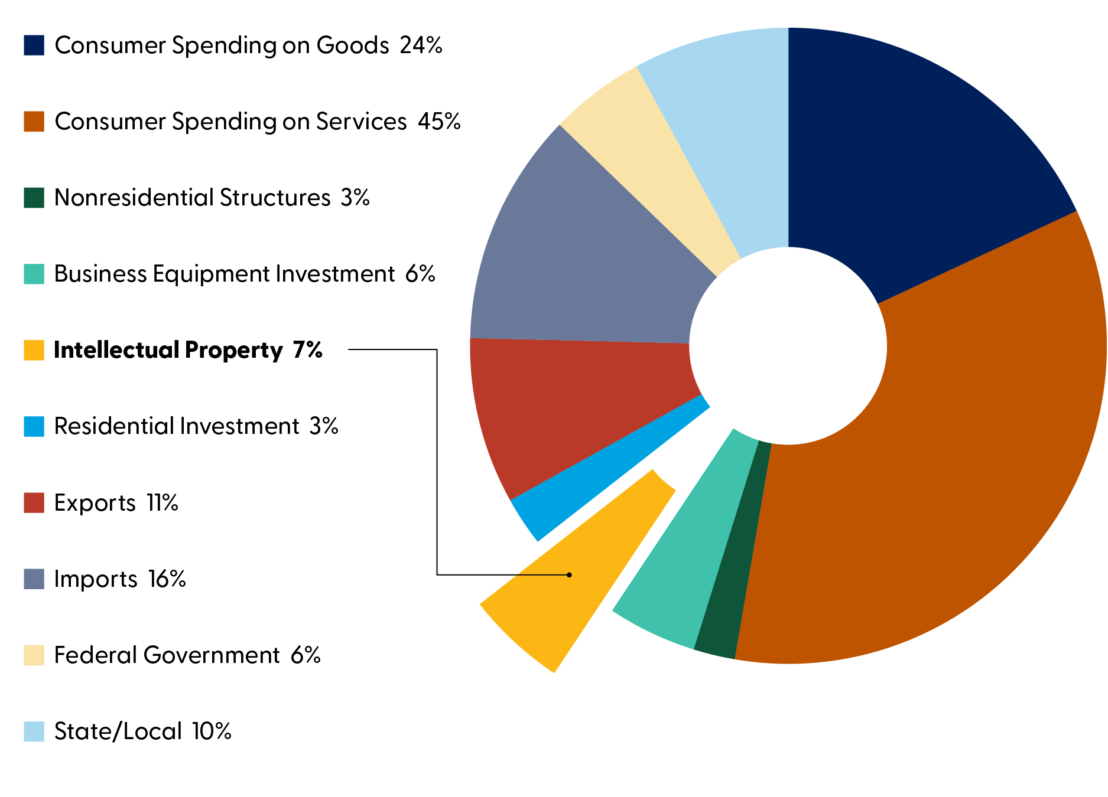
Intellectual Property Will
Be Increasingly Important to Growth
Source: LPL Research, U.S. Bureau of Economic Analysis, 12/01/25

Slide 5
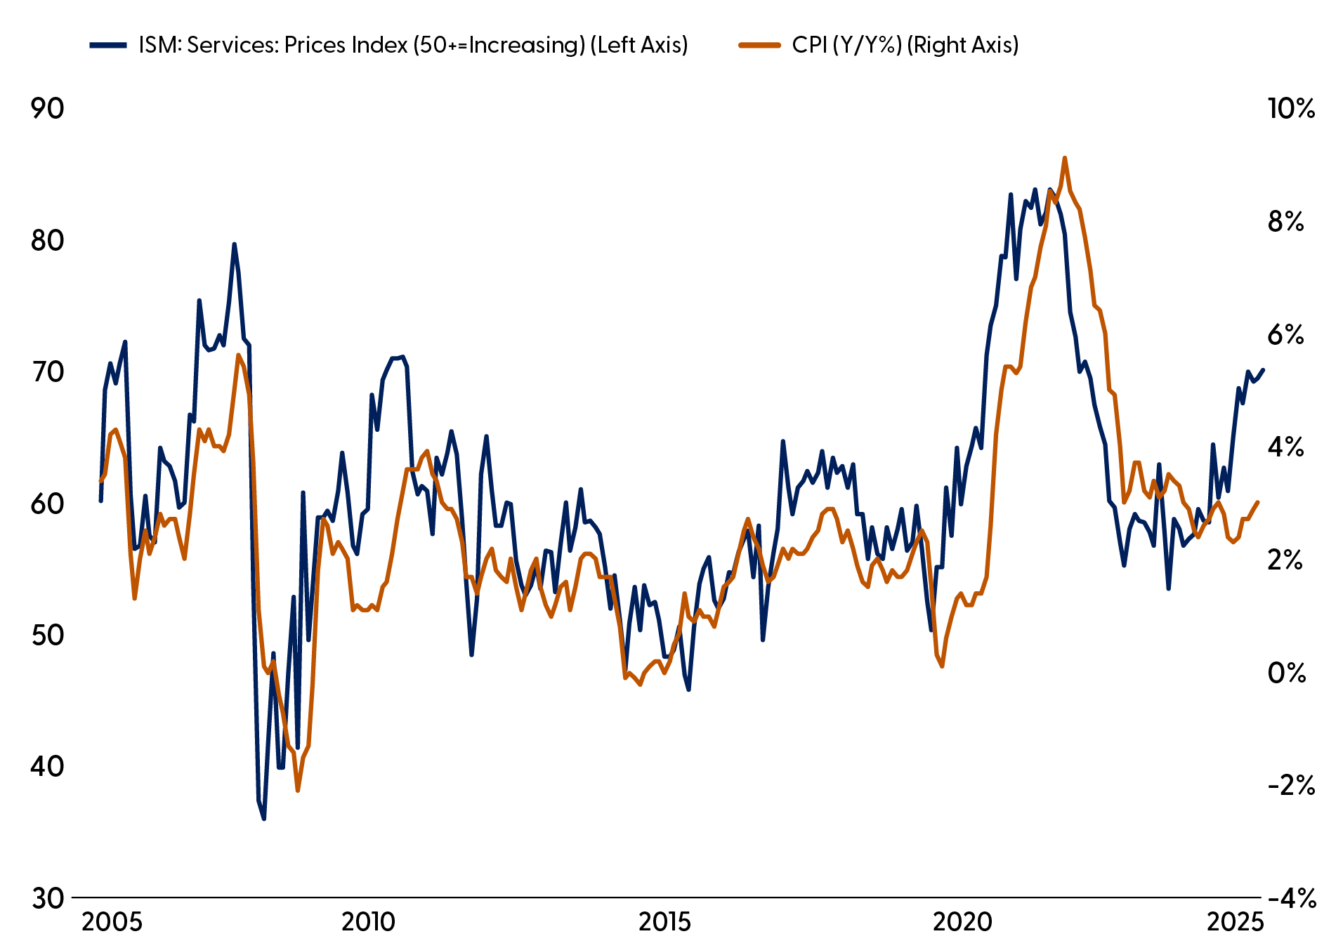
Near-Term Pain but Inflation May Improve in the New Year
Source: LPL Research, ISM, Bureau of Labor Statistics 12/01/25. All indexes are unmanaged and cannot be invested into directly. Past performance is no guarantee of future results.

Slide 6
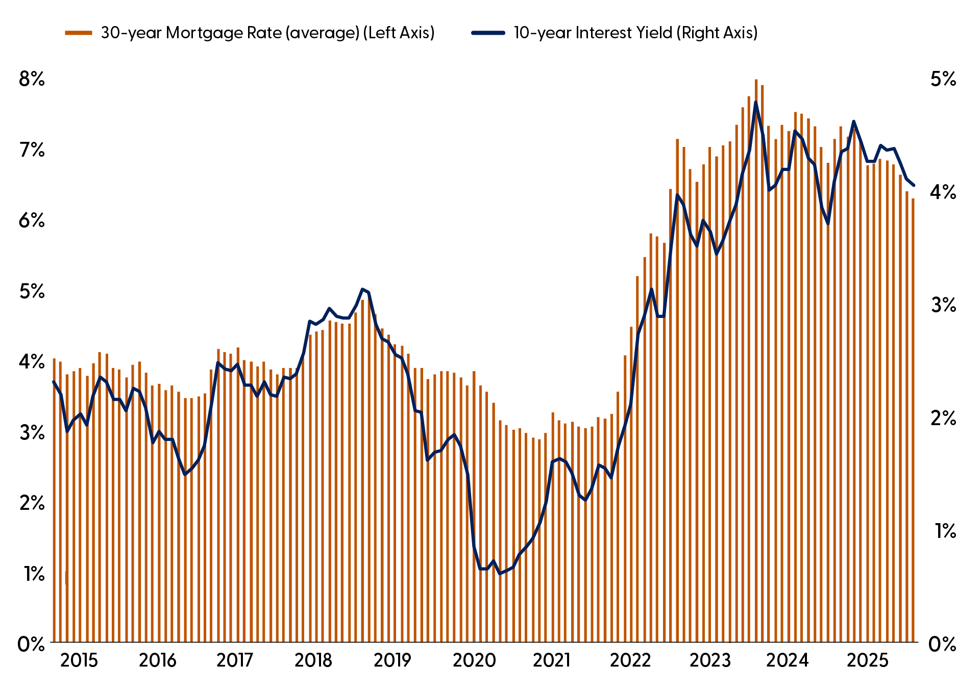
The 10-Year Treasury Is the Anchor for Mortgage Pricing
Source: LPL Research, Bloomberg, Federal Reserve Board 11/05/25. Past performance is no guarantee of future results.

Slide 7
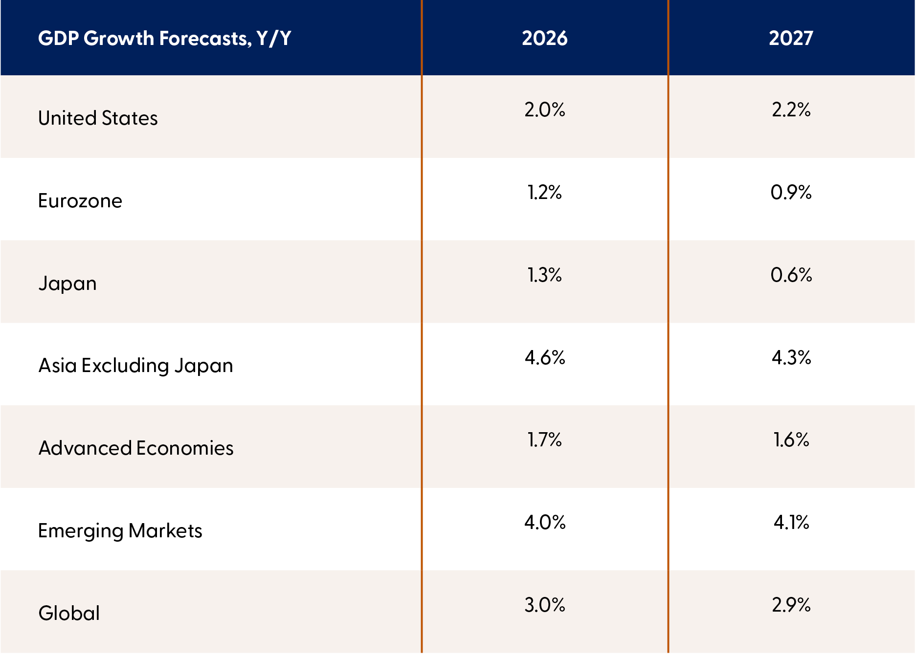
Tailwinds to Growth for the U.S.
Source: LPL Research, European Central Bank, Bank of Japan, IMF 12/01/25. Past performance is no guarantee of future results.

Slide 8
Policy Tailwinds and AI to Power Equities in 2026
Stocks

Slide 9
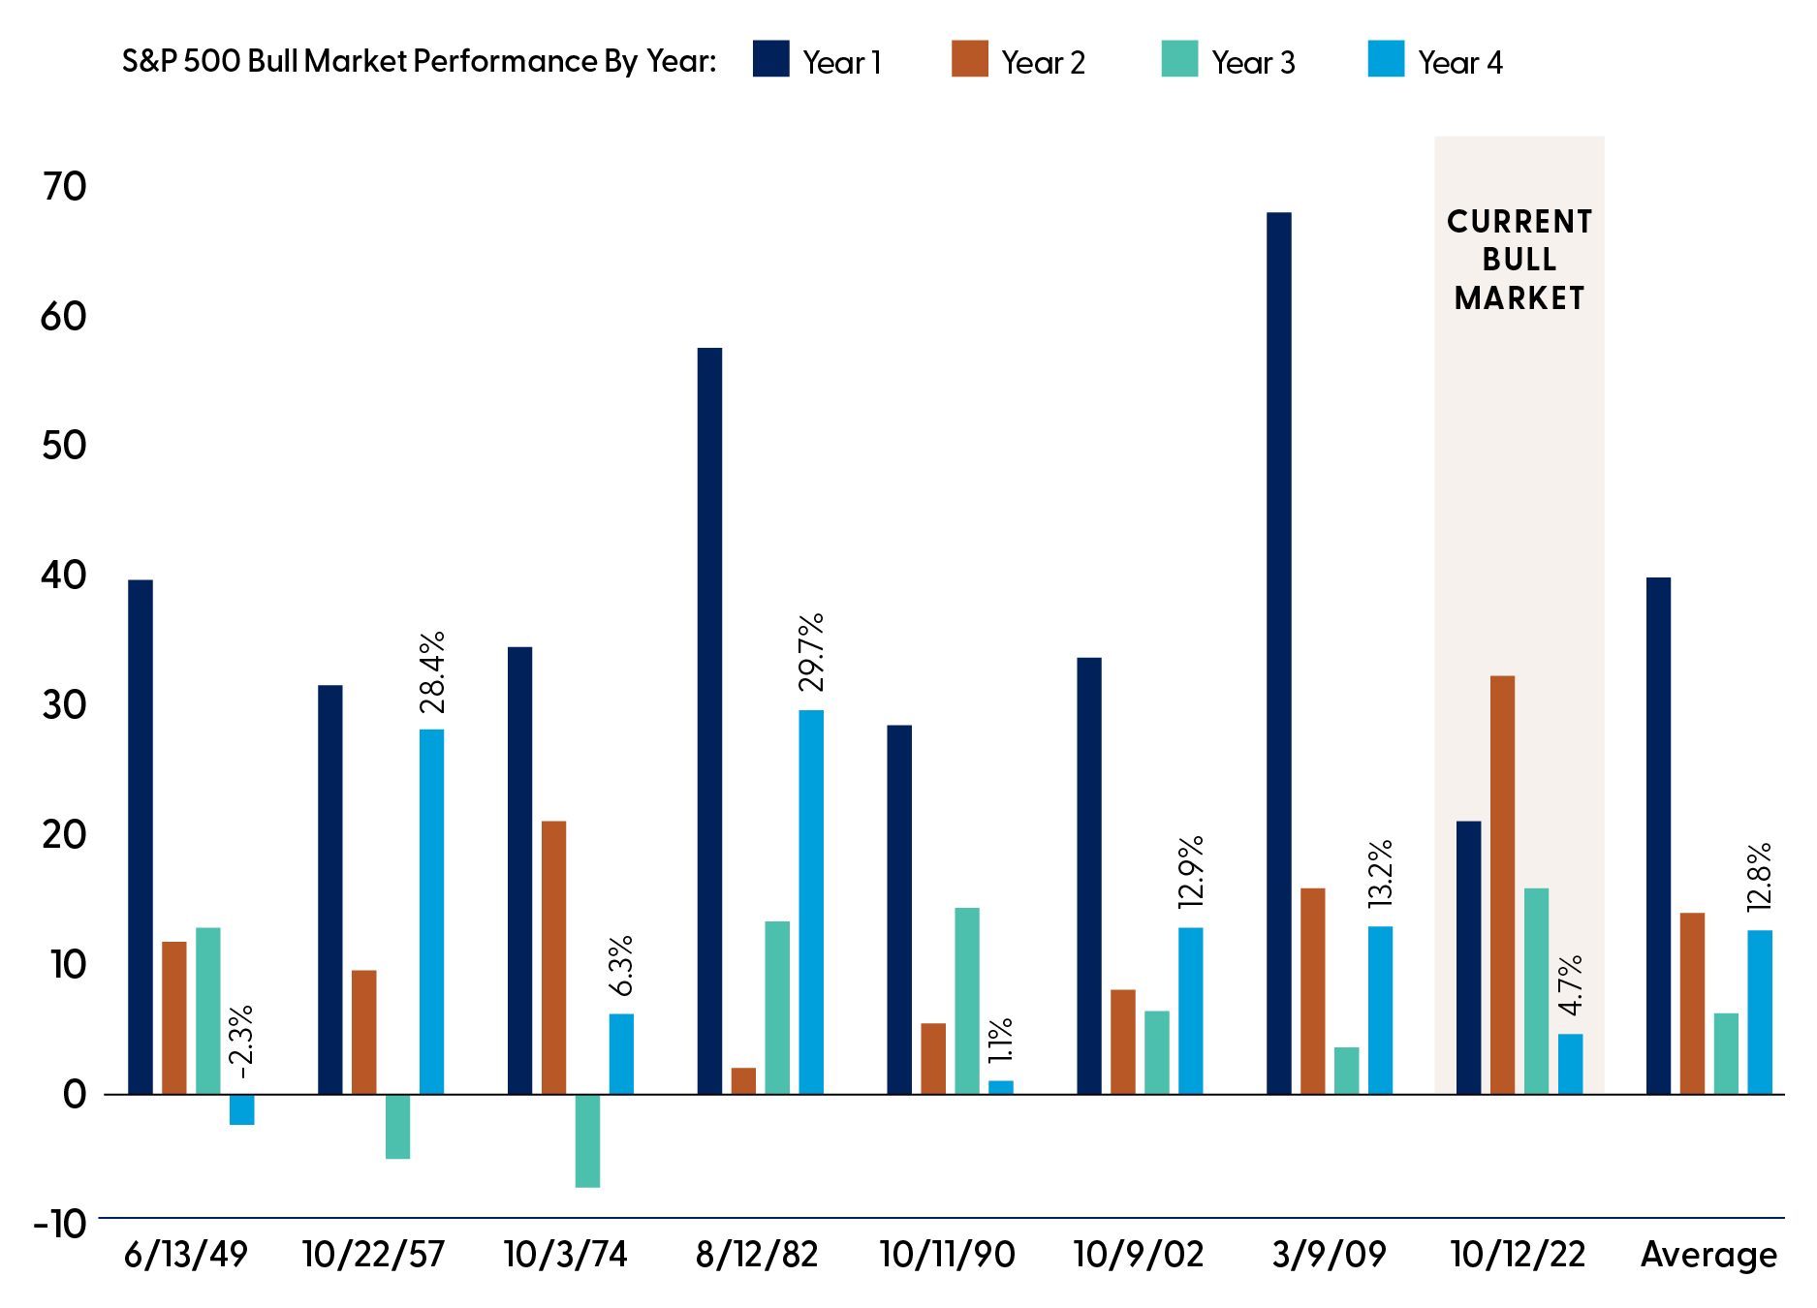
History Points to a Strong Fourth Year for This
Bull Market
Source: LPL Research, Bloomberg 12/01/25. Only S&P 500 bull markets that made it through a fourth year are shown, in addition to the current bull market. All indexes are unmanaged and cannot be invested in directly. Past performance is no guarantee of future results. The modern design of the S&P 500 stock index was first launched in 1957. Performance back to 1950 incorporates the performance of the predecessor index, the S&P 90.

Slide 10
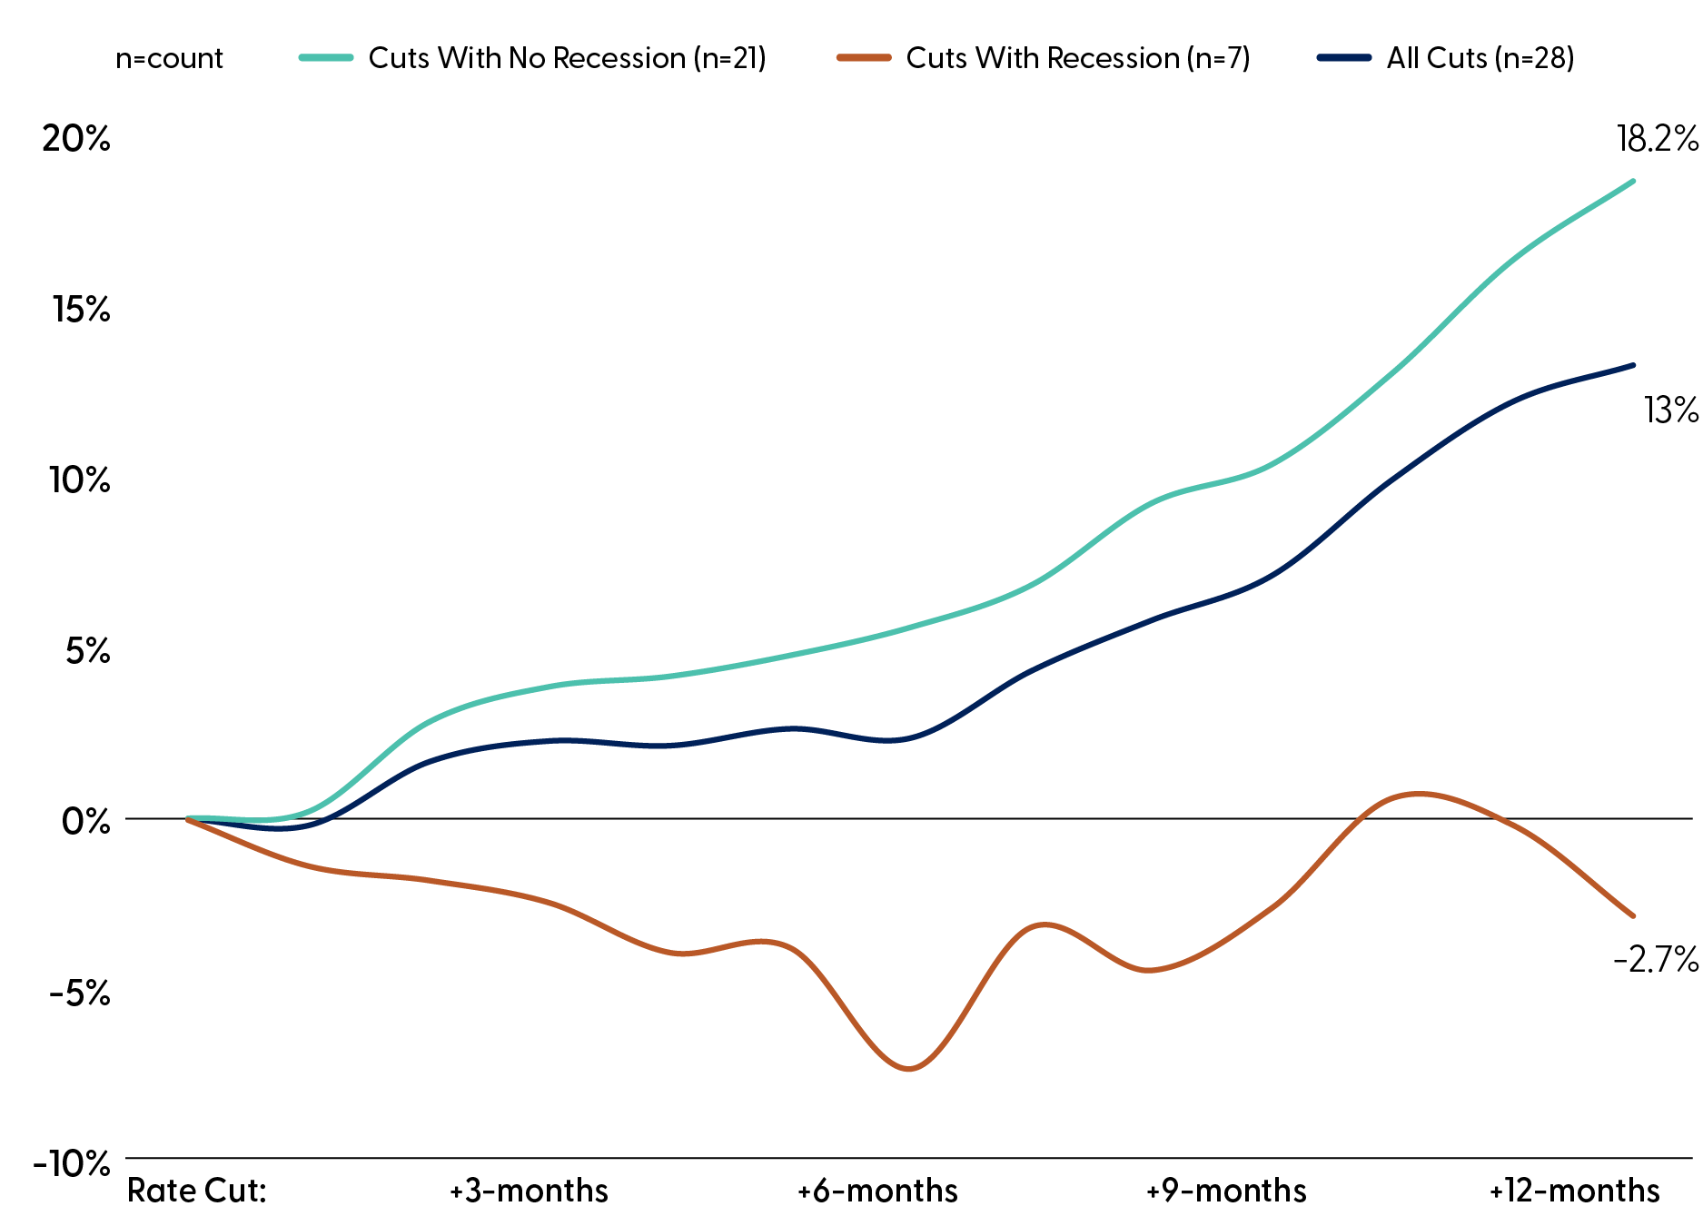
S&P 500 Performance
After the Fed Cuts Rates At/Near Record Highs
Source: LPL Research, Bloomberg 11/06/25. At/Near record highs defined as periods when the S&P 500 was within 3% of an all-time high. Data based on dates from 1984–YTD. Cuts with recession are defined as Federal Reserve interest rates occurring within six months of a recession. All indexes are unmanaged and cannot be invested in directly. Past performance is no guarantee of future results.

Slide 11
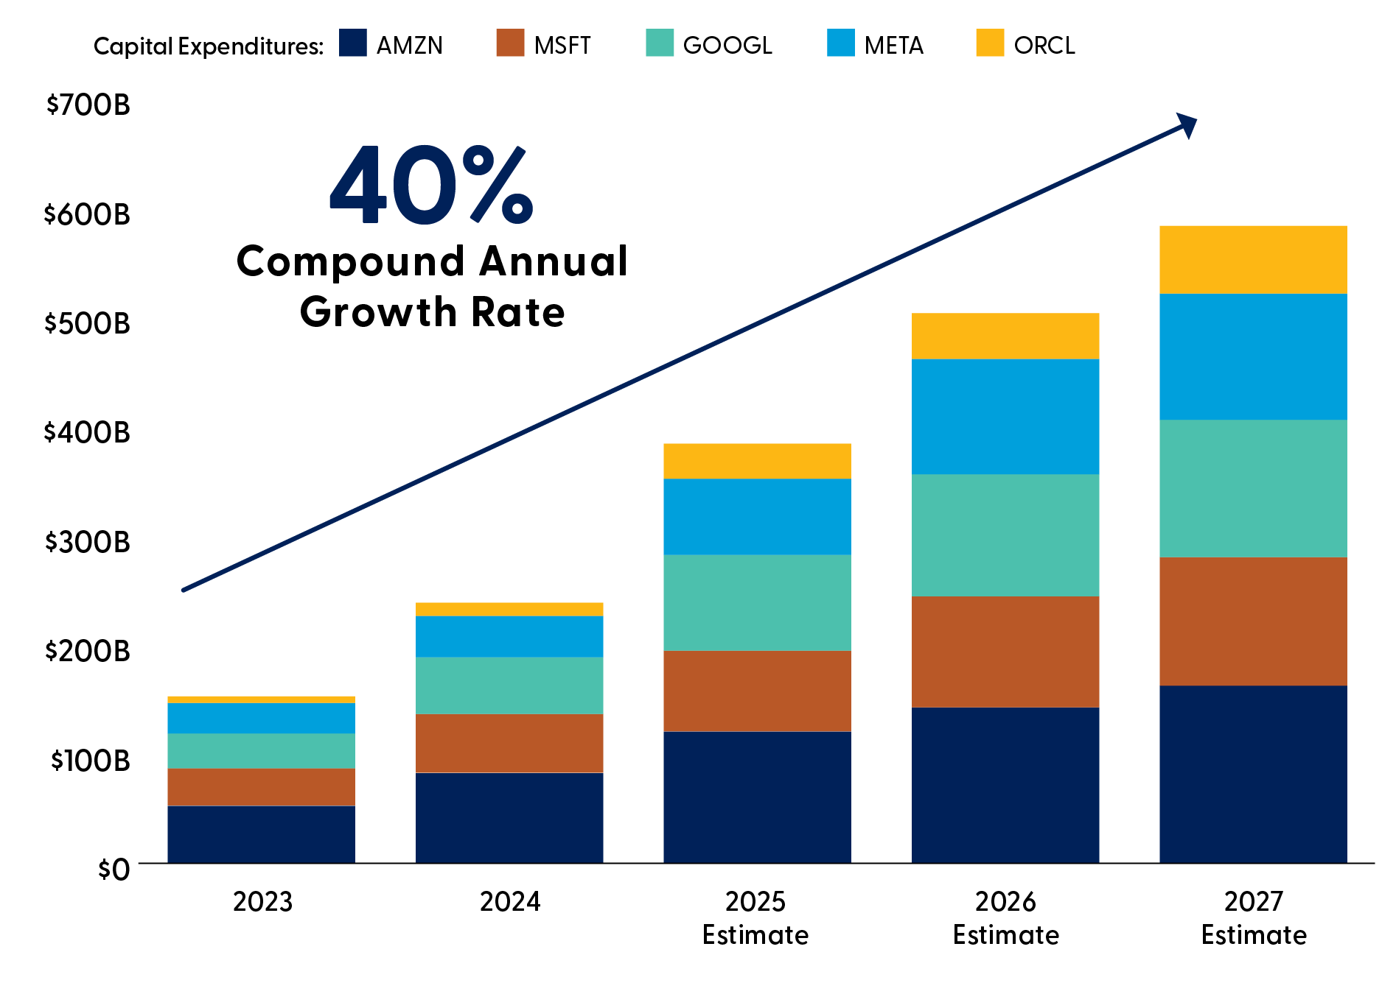
AI Investment by the Hyperscalers
Is Massive and Still Increasing at a Solid Clip
Source: LPL Research, Bloomberg, Company Reports 11/05/25. Hyperscalers include Alphabet (GOOG/L), Amazon (AMZN), Meta (META), Microsoft (MSFT), and Oracle (ORCL). Past performance is no guarantee of future results. Estimates may not materialize as predicted and are subject to change.

Slide 12
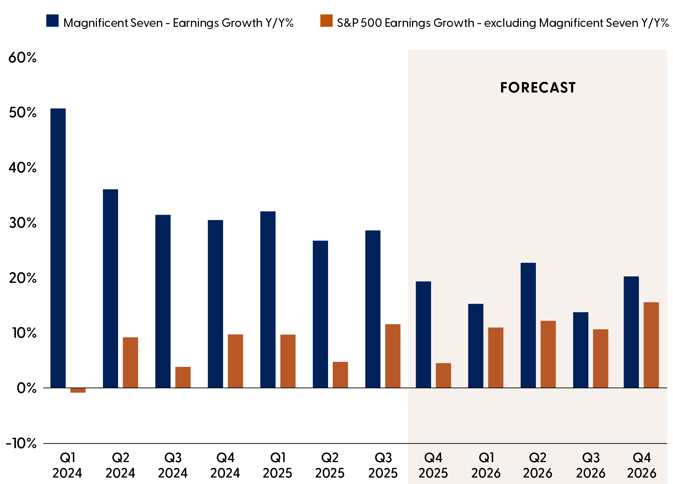
Magnificent
Seven Remains a Powerful Earnings Driver
Source: LPL Research, Bloomberg 12/01/25. Magnificent Seven includes Alphabet (GOOG/L), Amazon (AMZN), Apple (AAPL), Meta (META), Microsoft (MSFT), NVIDIA (NVDA), and Tesla (TSLA). All indexes are unmanaged and cannot be invested in directly. Past performance is no guarantee of future results. Estimates may not materialize as predicted and are subject to change.

Slide 13
Regarding Midterms
Midterms

Slide 14
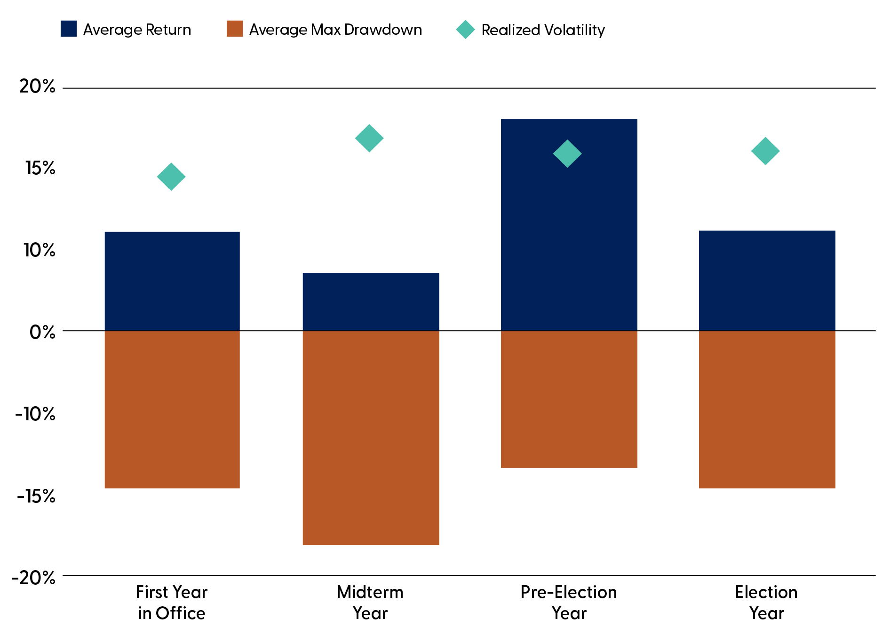
S&P 500 Performance During the Presidential Cycle (1950–YTD)
Source: LPL Research, Bloomberg 11/05/25. All indexes are unmanaged and cannot be invested in directly. Past performance is no guarantee of future results. The modern design of the S&P 500 stock index was first launched in 1957. Performance back to 1950 incorporates the performance of the predecessor index, the S&P 90.

Slide 15
Navigating Neutral
Bonds

Slide 16
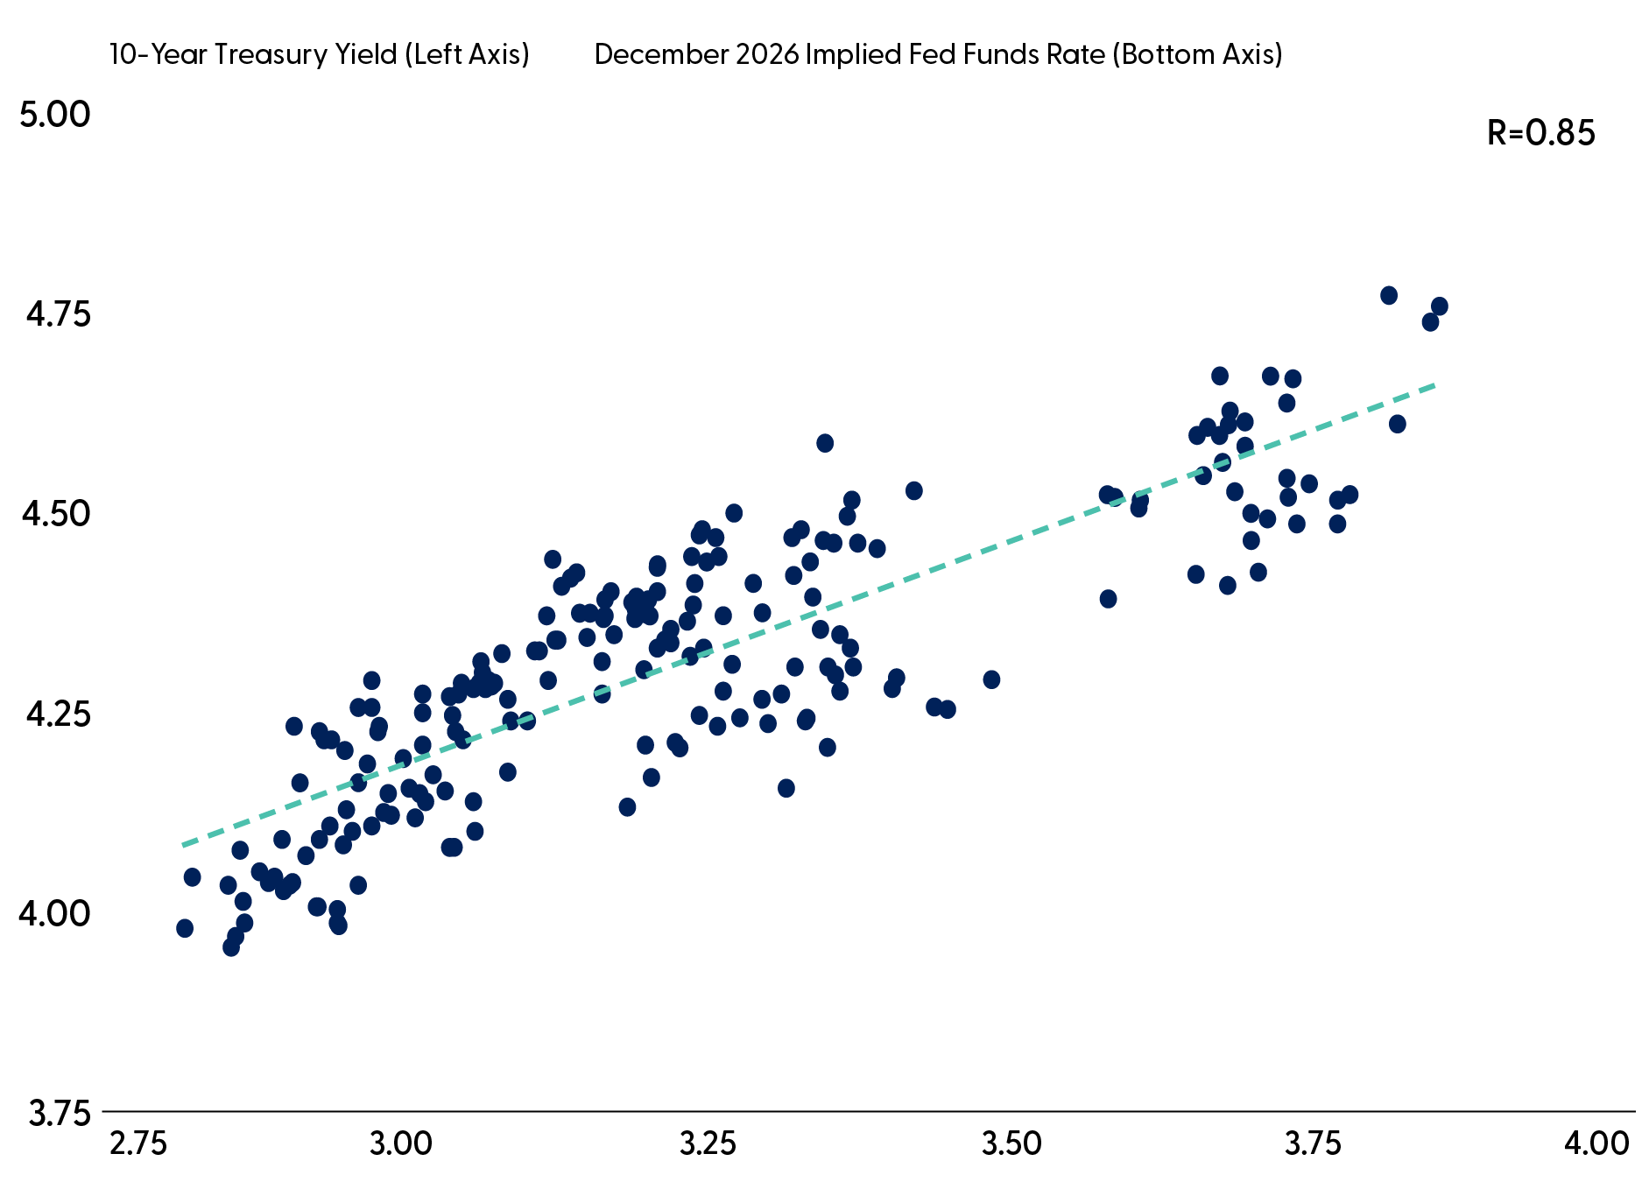
10-Year Treasury Is Highly Correlated to the Expected
Fed Funds
Trough Rate
Source: LPL Research, Bloomberg, 10/31/25. Past performance is no guarantee of future results.

Slide 17
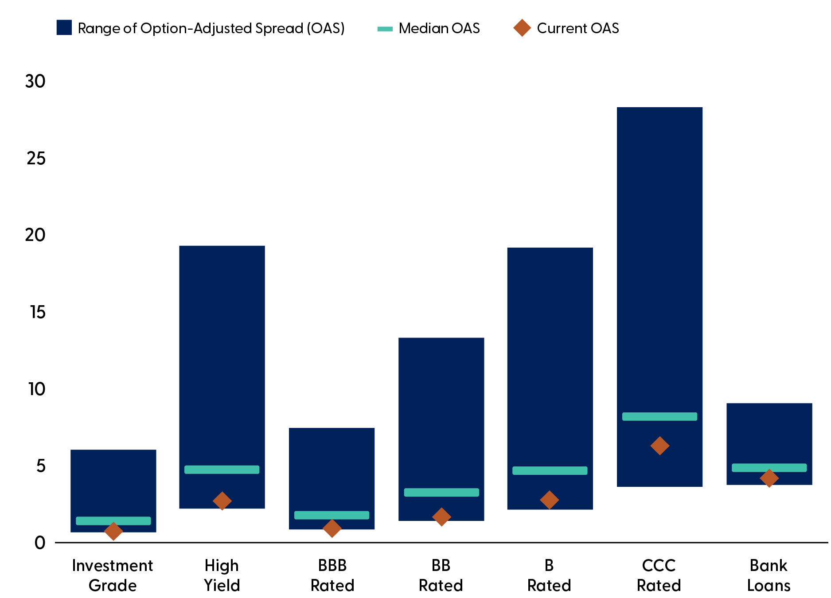
Spreads for Most Credit Markets Remain Below Long-Term Averages
Source: LPL Research, Bloomberg, 10/31/25. All indexes are unmanaged and cannot be invested into directly. Past performance is no guarantee of future results.

Slide 18
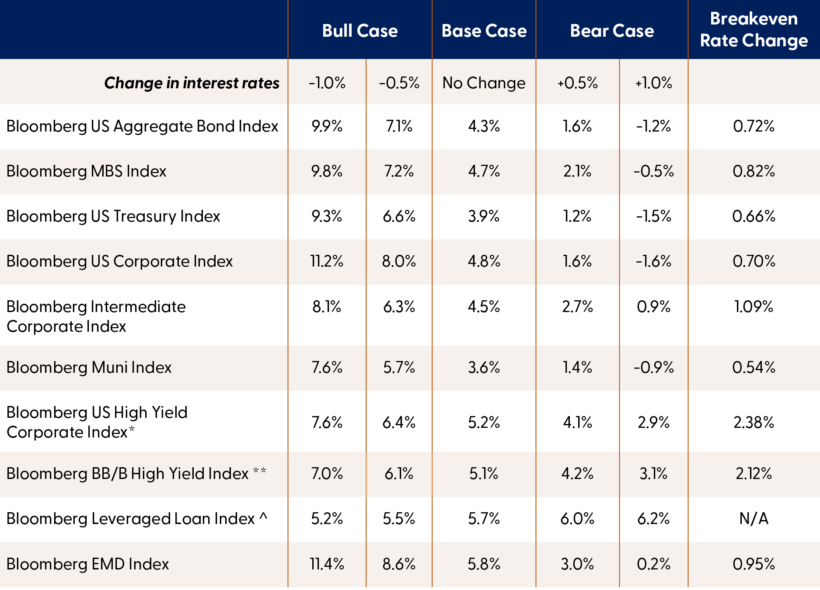
Hypothetical Returns: Interest Rate Scenario Analysis
*Assumes 3% default rate and 40% recovery rate
** Assumes 2% default rate and 50% recovery rate
^ Assumes 5% default rate and 40% recovery rate
Source: LPL Research, Bloomberg, 10/31/25. All indexes are unmanaged and cannot be invested into directly. Past performance is no guarantee of future results. This is a hypothetical example and is not representative of any specific investment. Your results may vary.

Slide 19
Seeking Resilience Through Alts
Alternative Investments

Slide 20
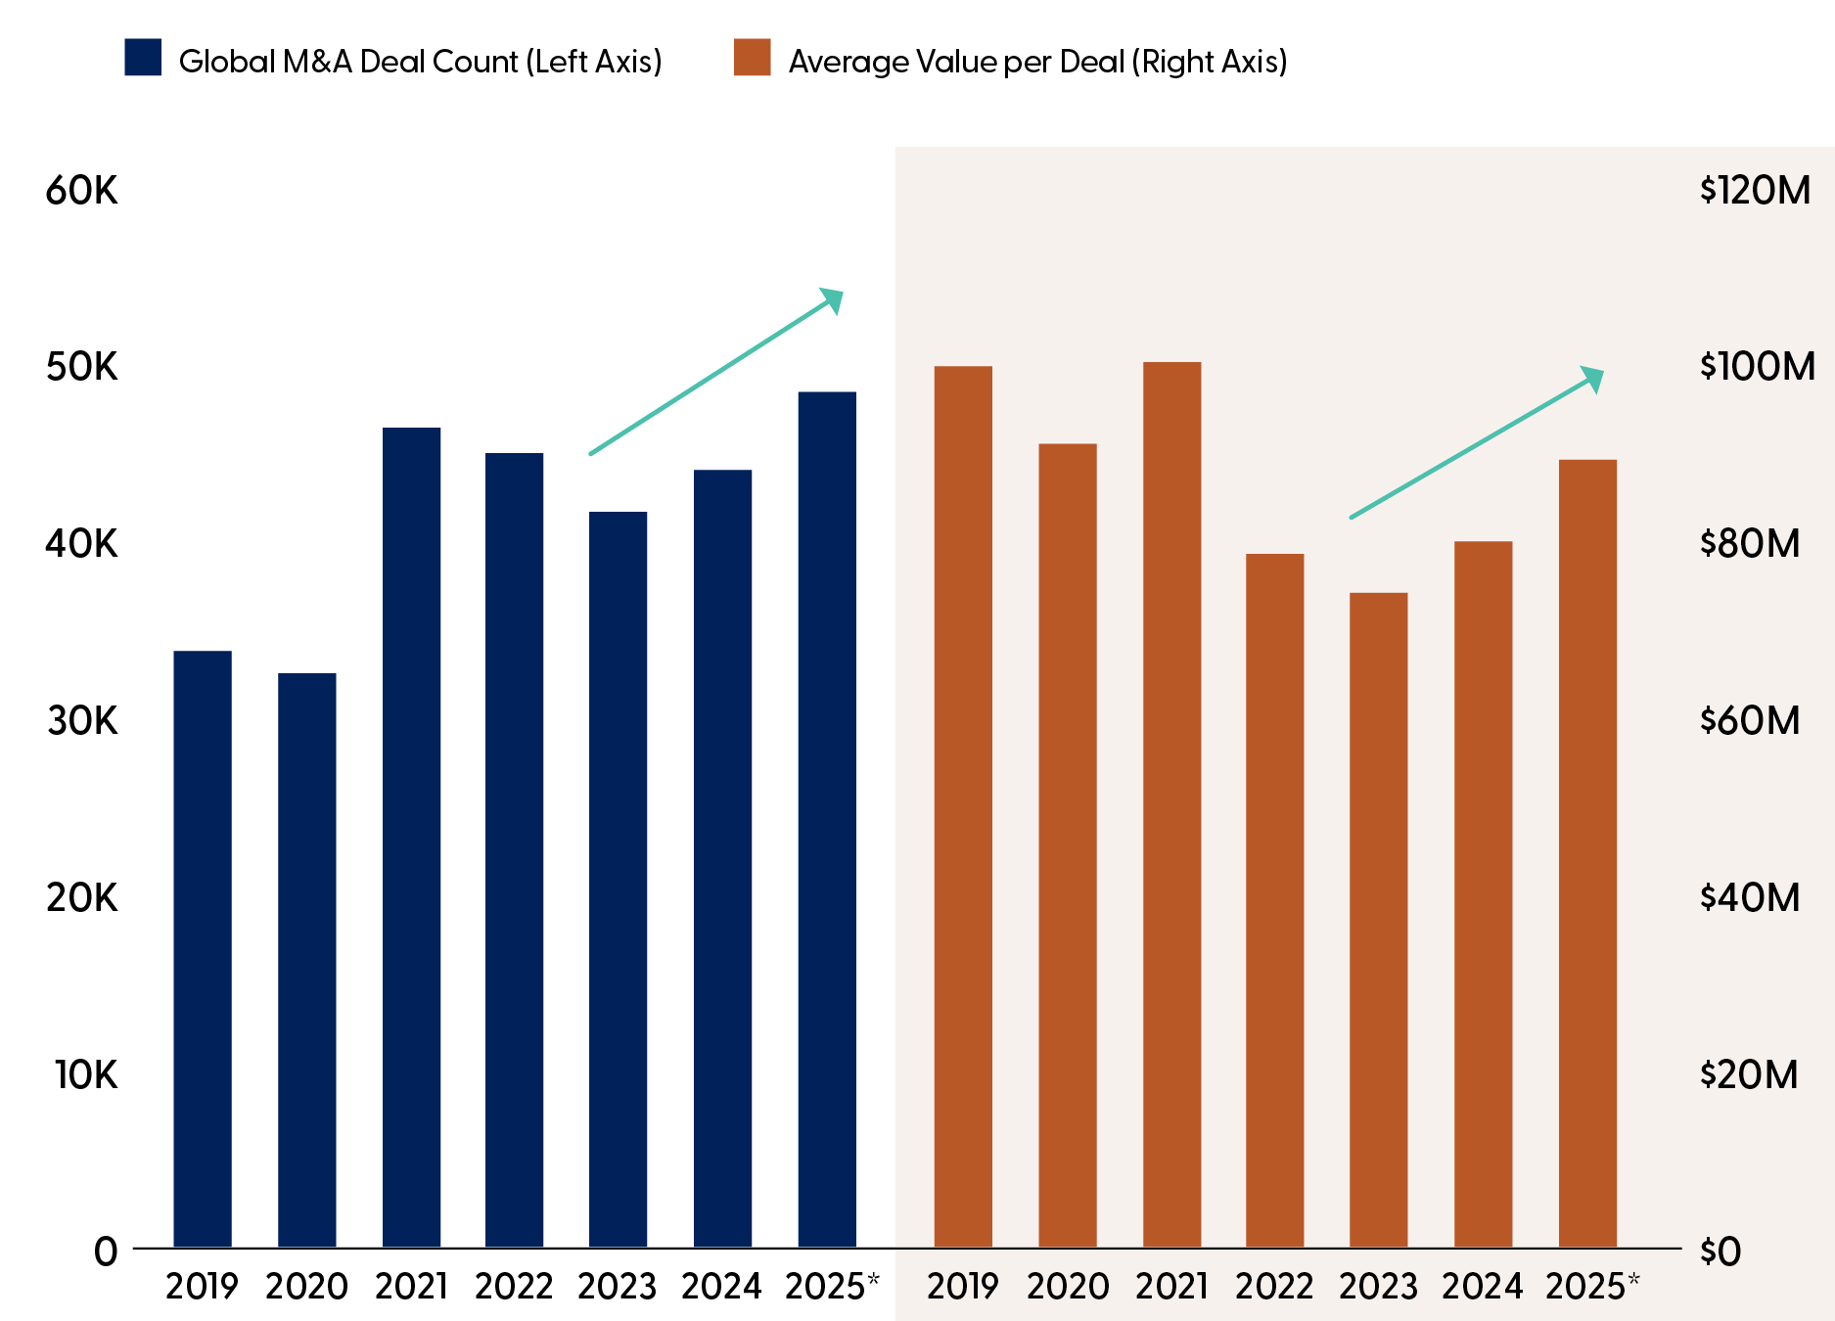
M&A Activity Is Building Momentum As Larger Deals Are Being Executed
Source: LPL Research, Pitchbook 09/30/25. Past performance is no guarantee of future results.
*Estimate

Slide 21
U.S. Dollar Outlook: From Dominance to Disruption
Currencies

Slide 22
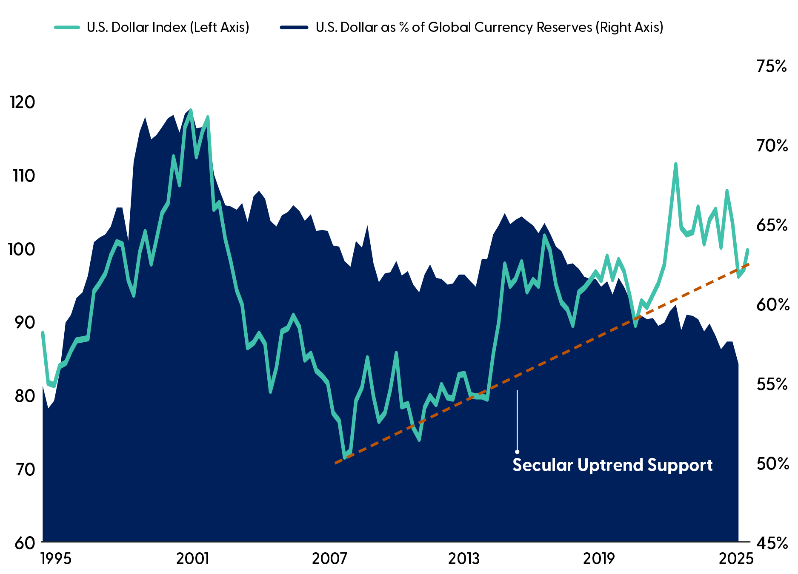
The Dollar
Is Down, but Not Out
Source: LPL Research, Bloomberg 11/05/25. All indexes are unmanaged and cannot be invested in directly. Past performance is no guarantee of future results.

Slide 23
The New Commodity Playbook: Geopolitics, AI, and the Path to a Supercycle
Commodities

Slide 24
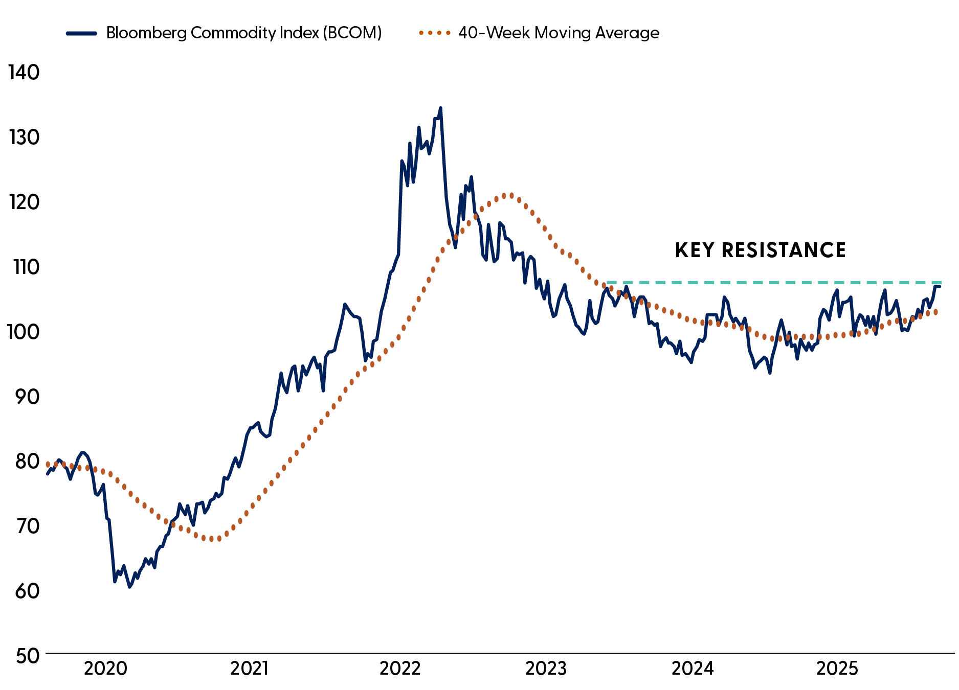
Commodities Are on the Verge of a Breakout
Source: LPL Research, Bloomberg 11/05/25. Past performance is no guarantee of future results. All indexes are unmanaged and cannot be invested in directly.

Slide 25
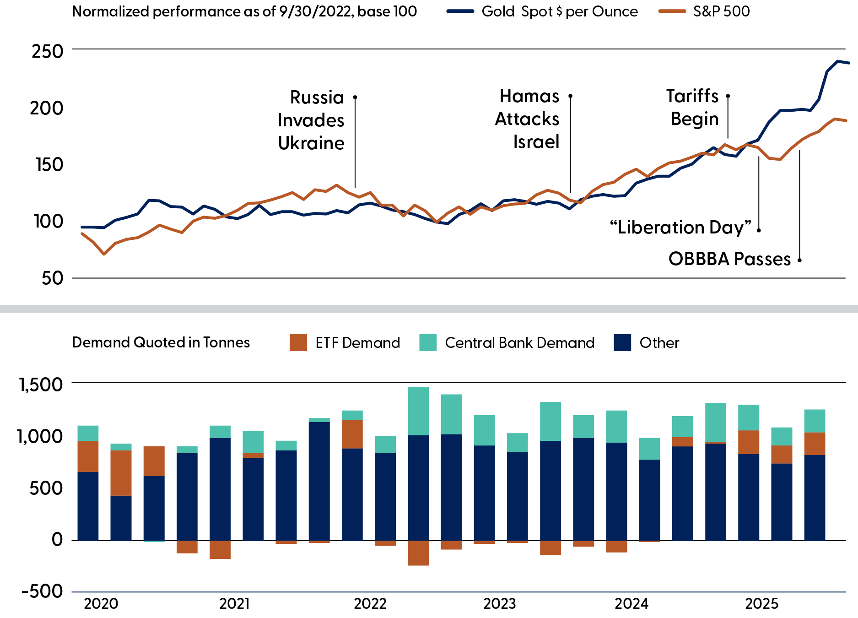
Geopolitics and Trade Have
Been Important Factors Behind Gold's Outperformance
Source: LPL Research, World Gold Council, Bloomberg 11/05/25. All indexes are unmanaged and cannot be invested in directly.
Past performance is no guarantee
of future results.

Slide 26
Disclosures
The opinions, statements, and forecasts presented herein are general information only and are not intended to provide specific investment advice or recommendations for any individual. It does not take into account the specific investment objectives, tax and financial condition, or particular needs of any specific person. There is no assurance that the strategies or techniques discussed are suitable for all investors or will be successful. To determine which investment(s) may be appropriate for you, please consult your financial professional prior to investing.
Any forward-looking statements, including the economic forecasts herein, may not develop as predicted and are subject to change based on future market and other conditions. All performance referenced is historical and is no guarantee of future results.
References to markets, asset classes, and sectors are generally regarding the corresponding market index. Indexes are unmanaged statistical composites and cannot be invested in directly. Index performance is not indicative of the performance of any investment and does not reflect fees, expenses, or sales charges. All performance referenced is historical and is no guarantee of future results.
General Risk Disclosures
Investing involves risk including the potential loss of principal.
Alternative investments may not be suitable for all investors and should be considered as an investment for the risk capital portion of the investor’s portfolio. The strategies employed in the management of alternative investments may accelerate the velocity of potential losses.
Managed futures are speculative, use significant leverage, may carry substantial charges, and should only be considered suitable for the risk capital portion of an investor's portfolio.
Investing in stock includes numerous specific risks including the fluctuation of dividend, loss of principal, and potential illiquidity of the investment in a falling market. Because of their narrow focus, sector investing will be subject to greater volatility than investing more broadly across many sectors and companies. Value investments can perform differently from the market as a whole. They can remain undervalued by the market for long periods of time. The prices of small and mid-cap stocks are generally more volatile than large cap stocks.

Slide 27
Disclosures
General Risk Disclosures (continued)
Bonds are subject to market and interest rate risk if sold prior to maturity. Bond values will decline as interest rates rise and bonds are subject to availability and change in price. Bond yields are subject to change. Certain call or special redemption features may exist which could impact yield. Government bonds and Treasury bills are guaranteed by the U.S. government as to the timely payment of principal and interest and, if held to maturity, offer a fixed rate of return and fixed principal value. Corporate bonds are considered higher risk than government bonds but normally offer a higher yield and are subject to market, interest rate, and credit risk, as well as additional risks based on the quality of issuer coupon rate, price, yield, maturity, and redemption features. Mortgage-backed securities are subject to credit, default, prepayment, extension, market, and interest rate risk.
International debt securities involve special additional risks. These risks include, but are not limited to, currency risk, geopolitical and regulatory risk, and risk associated with varying settlement standards. These risks are often heightened for investments in emerging markets.
High yield/junk bonds (grade BB or below) are not investment grade securities, and are subject to higher interest rate, credit, and liquidity risks than those graded BBB and above. They generally should be part of a diversified portfolio for sophisticated investors.
The fast price swings of commodities will result in significant volatility in an investor's holdings. Commodities include increased risks, such as political, economic, and currency instability, and may not be suitable for all investors. Precious metal investing is subject to substantial fluctuation and potential for loss.
Any company names noted herein are for educational purposes only and not an indication of trading intent or a solicitation of their products or services. LPL Financial does not provide research on individual equities.

Slide 28
Disclosures
General Risk Disclosures (continued)
All index data from FactSet. International investing involves special risks such as currency fluctuation and political instability and may not be suitable for all investors. These risks are often heightened for investments in emerging markets.
All information is believed to be from reliable sources; however, LPL Financial makes no representation as to its completeness or accuracy.
Investing involves risks including possible loss of principal. No investment strategy or risk management technique can guarantee return or eliminate risk in all market environments. There is no guarantee that a diversified portfolio will enhance overall returns or outperform a non-diversified portfolio. Diversification does not protect against market risk. Investing in foreign and emerging markets debt or securities involves special additional risks. These risks include, but are not limited to, currency risk, geopolitical risk, and risk associated with varying accounting standards. Investing in emerging markets may accentuate these risks.
Asset allocation does not ensure a profit or protect against a loss.
General Definitions
Gross Domestic Product (GDP) is the monetary value of all the finished goods and services produced within a country’s borders in a specific time period, though GDP is usually calculated on an annual basis. It includes all of private and public consumption, government outlays, investments, and exports less imports that occur within a defined territory.
The PE ratio (price-to-earnings ratio) is a measure of the price paid for a share relative to the annual net income or profit earned by the firm per share. It is a financial ratio used for valuation: a higher PE ratio means that investors are paying more for each unit of net income, so the stock is more expensive compared to one with lower PE ratio.
Earnings per share (EPS) is the portion of a company’s profit allocated to each outstanding share of common stock. EPS serves as an indicator of a company’s profitability. Earnings per share is generally considered to be the single most important variable in determining a share’s price. It is also a major component used to calculate the price-to-earnings valuation ratio.
The Standard & Poor’s 500 Index is a capitalization-weighted index of 500 stocks designed to measure performance of the broad domestic economy through changes in the aggregate market value of 500 stocks representing all major industries.
The Bloomberg U.S. Aggregate Bond Index is an index of the U.S. investment-grade fixed-rate bond market, including both government and corporate bonds. The HFRI® Indices are broadly constructed indices designed to capture the breadth of hedge fund performance trends across all strategies and regions.

Slide 29
Disclosures
General Definitions (continued)
The HFRI Institutional Macro Index is a global, equal-weighted index of hedge funds with minimum assets under management of USD $500MM which report to the HFR Database and are open to new investments.
A company’s market capitalization is the market value of its outstanding shares. Market capitalization is calculated by multiplying the number of a company’s shares outstanding by its stock price per share. Classifications such as large cap, mid cap, and small cap are only approximations and may change over time.
Equity Definitions
Cyclical stocks typically relate to equity securities of companies whose price is affected by ups and downs in the overall economy and that sell discretionary items that consumers may buy more of during an economic expansion but cut back on during a recession. Counter-cyclical stocks tend to move in the opposite direction from the overall economy and with consumer staples which people continue to demand even during a downturn.
A Growth stock is a share in a company that is anticipated to grow at a rate significantly above the average for the market due to capital appreciation.
A Value stock is anticipated to grow above the average for the market due to trading at a lower price relative to its fundamentals, such as dividends, earnings, or sales.
Large cap stocks are issued by corporations with a market capitalization of $10 billion or more, and small cap stocks are issued by corporations with a market capitalization between $250 million and $2 billion.
Fixed Income Definitions
Credit Quality is one of the principal criteria for judging the investment quality of a bond or bond mutual fund. As the term implies, credit quality informs investors of a bond or bond portfolio’s credit worthiness, or risk of default. Credit ratings are published rankings based on detailed financial analyses by a credit bureau specifically as it relates to the bond issuer’s ability to meet debt obligations. The highest rating is AAA, and the lowest is D. Securities with credit ratings of BBB and above are considered investment grade.
The credit spread is the yield of corporate bonds less the yield on comparable maturity Treasury debt. This is a market-based estimate of the amount of fear in the bond market. Base-rated bonds are the lowest quality bonds that are considered investment-grade, rather than high-yield. They best reflect the stresses across the quality spectrum.
The Bloomberg Commodity Index (BCOM) is made up of 24 exchange-traded futures on physical commodities, representing 22 commodities which are weighted to account for economic significance and market liquidity.

Slide 30
This research material has been prepared by LPL Financial LLC.
Not Insured by FDIC/NCUA or Any Other Government Agency | Not Bank/Credit Union Guaranteed | Not Bank/Credit Union Deposits or Obligations | May Lose Value
RES-0006041-0925 | For Public Use | Tracking #826783 | #826785 (Exp. 12/2026)

